Slide 1

Data Flow Diagram
(Chapter 05)
MIS 372 Spring 2022

Slide 2

Do Check-in First
https://forms.office.com/r/nwsEdTduTE

Slide 3
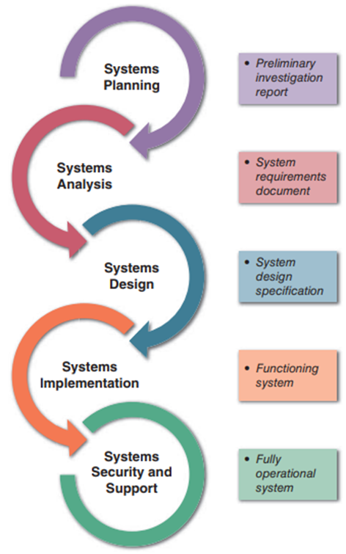
Where We Are in SDLC

Slide 4
Learning Objectives
1. Process Model vs. Physical Model
2. An overview of DFD
3. Key Elements in DFD
4. Plotting DFD Workflow
5. Data Dictionary and Others

Slide 5
1. Process Model vs. Physical Model
Process model is a graphical way of representing how a business system should operate.
Processes
Data path
It is also known as logical model
Process description only
No implementation details are revealed
Computerized? Manual? Paper? Web? File cabinet? Database?
Analysts would like to focus on the business processes rather than being distracted by the technicalities.

Slide 6
DFD Workflow
Requirements
Higher-Level DFD
Lower-Level DFD
Physical Model
Physical details of business processes will be expressed through the physical models.
User stories will be analyzed to provide critical inputs to draft logical models such as Data Flow Diagram (DFD).
Uses various symbols to show how the system transforms input data into useful information
Shows how data moves through an information system but does not show program logic or processing steps

Slide 7
Four-Model Approach
Many analysts follow a four-model approach
Current Physical Model
To-Be Logical Model
To-be Physical Model
Current Logical Model
“Reverse Engineering”
“Design of Improved”

Slide 8
2. A Case of LCA (Dennis et al., 2014)
Description: the Lawn Chemical Applicator (LCA) specifies the lawn chemical needed for a job by entering its name or ID number. The system satisfies the request by reserving the quantity requested or the quantity available and notifying the Chemical Supply Warehouse of the pick-up.
Originator | Input | Output | Destination
LCA Lawn chemical supply datastore | Chemical name or ID List of approved chemicals Chemical quantity on hand Quantity needed Request confirmation Request quantity Available or cancellation | Chemical pick-up authorization Chemical pick-up notice Lawn chemical request Chemical outage notice | LCA Chemical Supply Warehouse Chemical Request datastore Purchasing

Slide 9
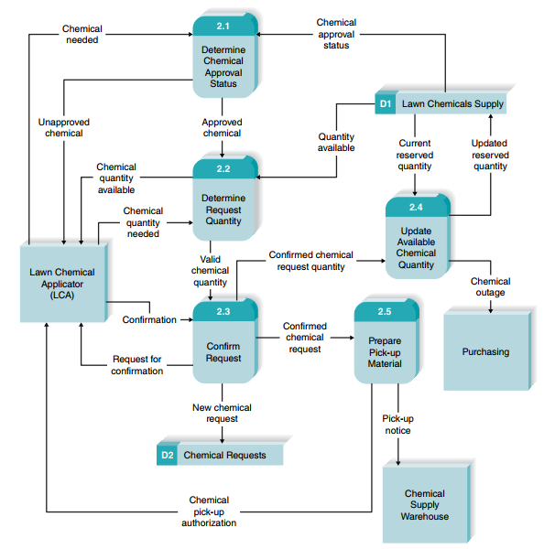

Slide 10
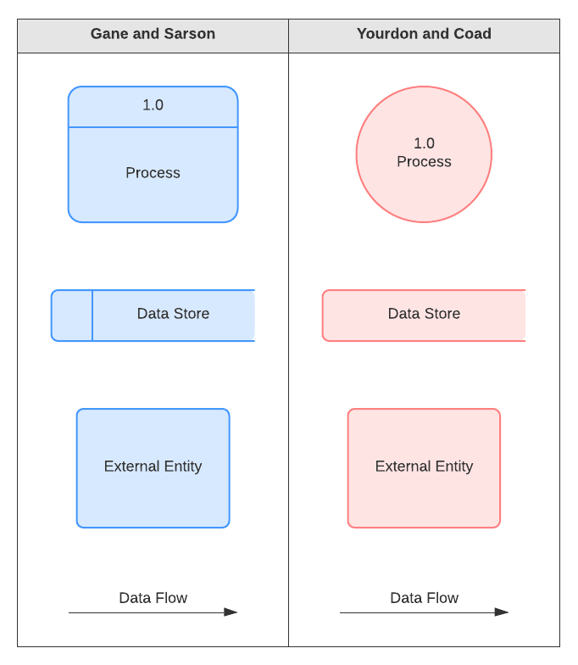
3. DFD Elements
Four basic symbols represent processes, data flows, data stores, and external entities.
There are two versions.
To avoid confusion with flowchart, this course will stay with Gane & Sarson.

Slide 11
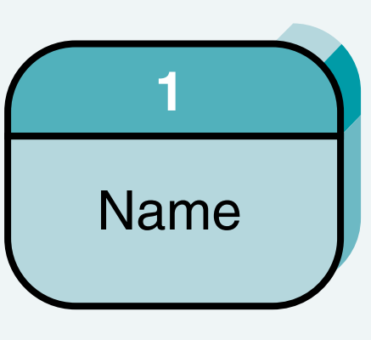
DFD Elements (1/4) – Process Symbol
Process receives input data and produces output
Contains business logic that transforms the data
Process name identifies a specific function
In DFDs, a process symbol can be referred to as a black box
Avoid using ‘and’ in the name. Only one activity if possible.
Remember:
Every process has
A number
A name (verb-noun phrase)
A description
At least one output data flow
At least one input data flow

Slide 12
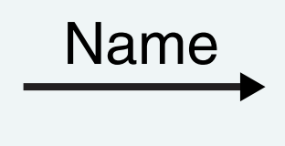
DFD Elements (2/4) – Data Flow Symbol
A data flow symbol
Is a Line with a single or double arrowhead
Expresses a single fact (e.g., qty. available) or a logical collection of several facts (e.g., new chemical request).
Every data flow should be named with a noun.
What data elements the flow contain will need to be clarified.
Data flow connects processes together.
Remember:
Every data flow has
A name (a noun)
A description
One or more connections to a processes.

Slide 13

DFD Elements (3/4) – Data Store
Represent data that the system stores
DFD does not show the detailed contents of a data store (data dictionary)
A data store must be connected to a process with a data flow
Data flow in and out from a data store.
Remember:
Every data flow has
A number
A name (a noun)
A description
One or more input data flows
One or more output data flows

Slide 14

DFD Elements (4/4) – External Entity
Shows how the system interfaces with the outside world
DFD shows only external entities that provide data to the system or receive output
There will be source and single entities.
Remember:
Every external entity has
A name (noun)
A description

Slide 15
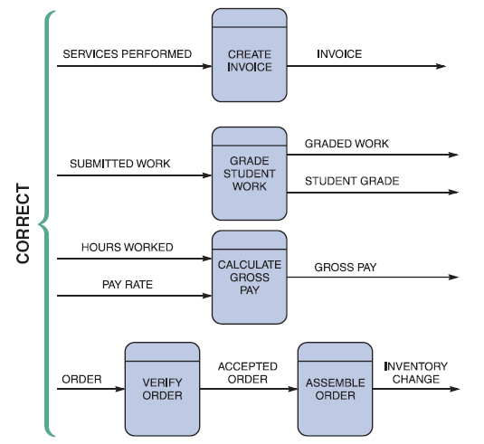
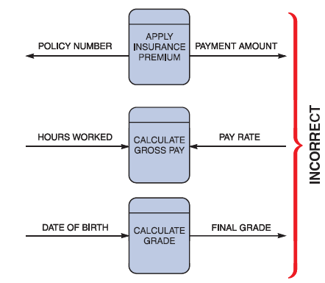
Examples of Data Flow + Process

Slide 16
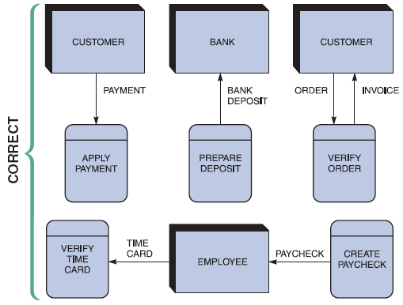
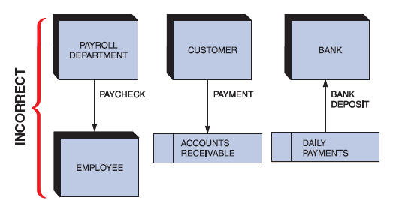
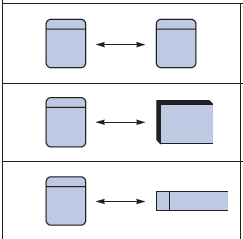
Examples of External Entities
What about these?

Slide 17
4. Plotting DFD Workflow
Context Diagram
(Top-Level)
Level 0 Diagram
Level 1 Diagram
Level 2+ Diagram
“Decomposition and Balancing”

Slide 18
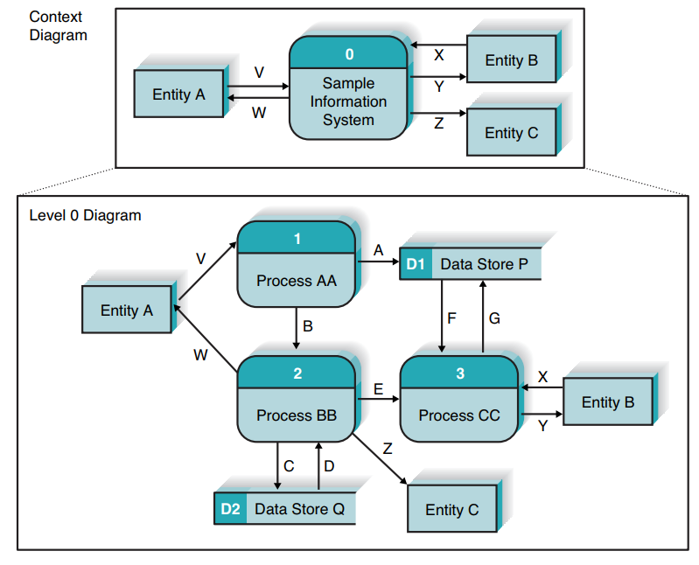
From Context Diagram to Level 0 Diagram
Context diagram shows the entire system in context with tis environment.
“Overall business as a single process”
The purpose of the level 0 DFD is to show all the major high-level processes of the system and how they relate to each other and to stored data.
Balancing: did the decomposition compromise anything?

Slide 19
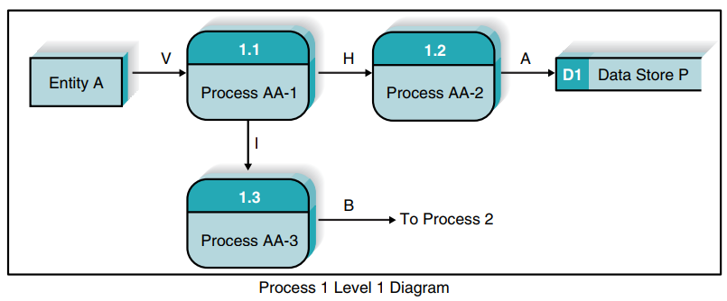
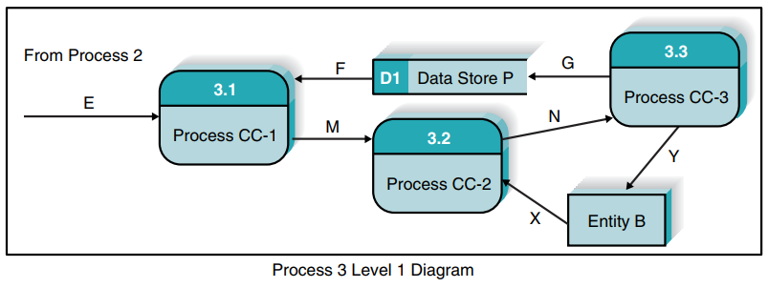
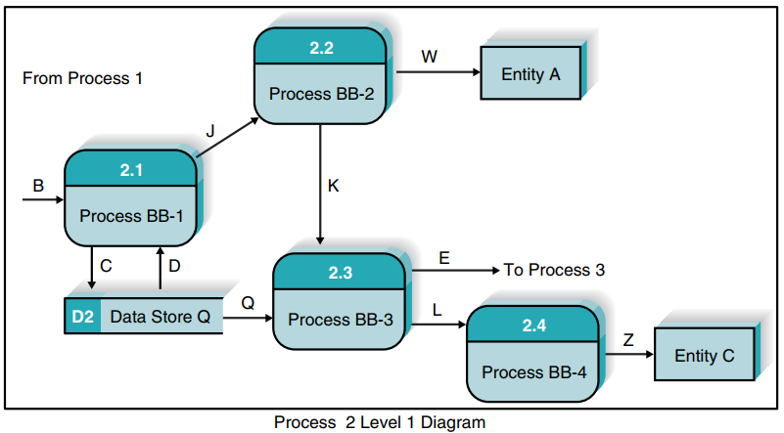
Lower-Level DFDs
The processes in the level 1 diagram are the children of the parent process in the level 0.

Slide 20
Validating the Data Flow Diagrams
Prevent Syntax Errors – ”Grammatical Errors” when creating a DFD
Within DFD
Process | Every process has a unique name that is an action-oriented verb phrase, a number, and a description. Every process has at least one input data flow. Every process has at least one output data flow. Output data flows usually have different names than input data flows because the process changes the input into a different output in some way. There are between three and seven processes per DFD.
Data Flow | Every data flow has a unique name that is a noun, and a description. Every data flow connects to at least one process. Data flows only in one direction (no two-headed arrows). A minimum number of data flow lines cross.
Data Store | Every data store has a unique name that is a noun, and a description. Every data store has at least one input data flow (which means to add new data or change existing data in the data store) on some page of the process model. Every data store has at least one output data flow (which means to read data from the data store) on some page of the process model.
External Entity | Every external entity has a unique name that is a noun, and a description. Every external entity has at least one input or output data flow.

Slide 21
Validating the Data Flow Diagrams (cont.)
Prevent Syntax Errors (cont.)
Across DFDs
Context diagram | Every set of DFDs must have one context diagram.
Viewpoint | There is a consistent viewpoint for the entire set of DFDs.
Decomposition | Every process is wholly and completely described by the processes on its children DFDs.
Balance | Every data flow, data store, and external entity on a higher level DFD is shown on the lower-level DFD that decomposes it.
Law of conservation of data (Prof. Dale Goodhue)
Data at rest stays at rest until moved by a process.
Processes cannot consume or create data.

Slide 22
Validating the Data Flow Diagrams (cont.)
Prevent Semantics Errors – Mistakes in documenting business processes
Semantics
Appropriate Representation | User validation Role-play processes
Consistent Decomposition | Examine lowest-level DFDs
Consistent Terminology | Examine names carefully
Appropriate Representation | User validation Role-play processes

Slide 23
Other Tips
When plotting Level 0 DFD, if too complicated, analysts are advised to plot DFD for each core process first (DFD fragment), then combine all the fragments.
If a process looks too “busy”, it is usually an indication that the process needs a lower-level DFD.
Not all processes need lower-level DFDs.

Slide 24
https://miro.com/app/board/uXjVOO2cTow=/?invite_link_id=891136048294

